Slide 1
Speed Distance Time
Year 11 Mathematics

Slide 2
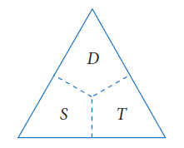

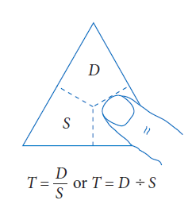
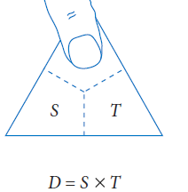
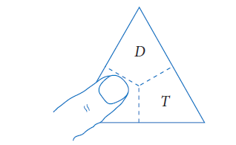
24
7
30
Date: 23/10/2018
Speed Distance Time
EQ – How do Distance Time graphs tell a story?
In order to calculate Speed Distance or Time use the Triangle method

Slide 3
We have a formula which connects
speed, distance and time:
Distance
Time
Speed =
This formula can be rearranged to give:
Distance
Speed
Time =
Distance =
Speed x Time
Units for Speed:
If we have the units of distance in kilometres (km) and the time in
hours (hr), the units for speed are km/hr.
If we have the units of distance in metres (m) and the time in
seconds (s), the units for speed are m/s.

Slide 4
Calculating the Speed
Example 1:
A train travelled 210 kilometres in 3 hours.
Calculate the average speed for the journey.
Distance
Time
Speed =
Put numbers
into formula
210
3
Speed =
Work out
210 ÷ 3
Speed = 70 km/hr

Slide 5
Calculating the Speed
Example 2:
A runner ran a total distance of 500 metres in 125 seconds. What was the average speed for the run?
Distance
Time
Speed =
Put numbers
into formula
500
125
Speed =
Work out
500 ÷ 125
Speed = 4 m/s

Slide 6
Calculating the Time
Example 1:
A car drove a distance of 80 kilometres at a constant speed of
50 kilometres per hour. How long did the journey take?
Distance
Speed
Time =
Put numbers
into formula
80
50
Time =
Work out
80 ÷ 50
Time = 1.6 h
Change 0.6 hours into minutes by multiplying
by 60
0.6 x 60 = 36
Write time in hours and minutes
Time = 1hour 36 minutes

Slide 7
Calculating the Time
Example 2:
A cyclist cycled for 15 kilometres at a constant speed of 12 kilometres per hour. For how long was the cyclist cycling?
Distance
Speed
Time =
Put numbers
into formula
15
12
Time =
Work out
15 ÷ 12
Time = 1.25 h
Change 0.25 hours into minutes by multiplying
by 60
0.25 x 60 = 15
Write time in hours and minutes
Time = 1hour 15 minutes

Slide 8
Calculating the Distance
Example 1:
A tram’s average speed was 36 km/hr over a journey which took two and a quarter hours. What was the total distance travelled?
Note:
two and a quarter hours is
2.25 hours.
Distance = Speed x Time
Put numbers
into formula
Distance =
36 x 2.25
Work out
36 x 2.25
Distance = 81 km

Slide 9
Calculating the Distance
Example 2:
A walker’s average speed was 3.4 km/hr over walk which took three hours and 12 minutes. What was the total distance travelled?
Note:
3 hours and 12 minutes is
3.2 hours.
Distance = Speed x Time
Put numbers
into formula
Distance =
3.4 x 3.2
Work out
3.4 x 3.2
Distance = 10.88 km

Slide 10
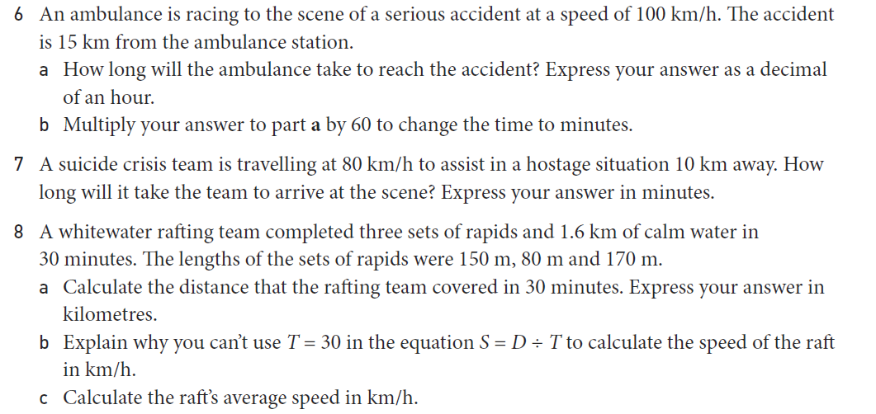
Task

Slide 11
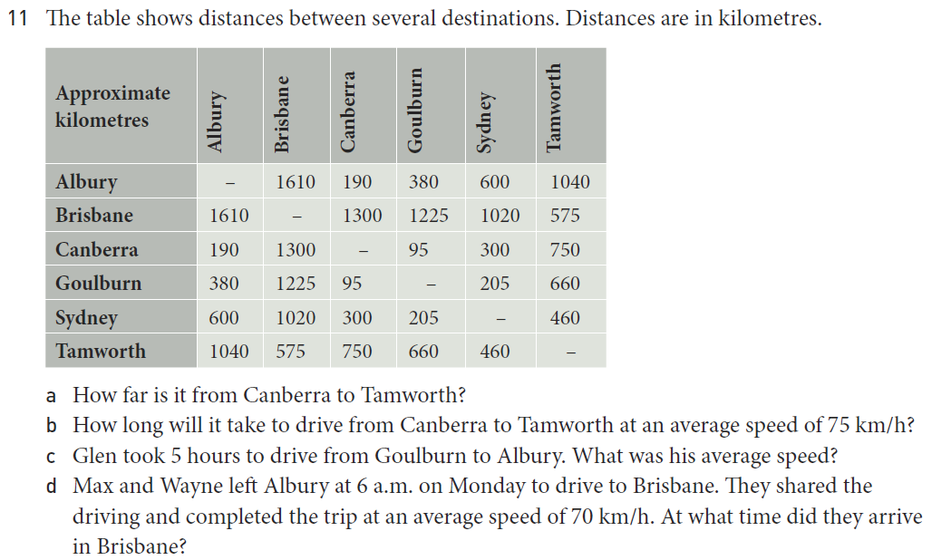
Task

